Slide 1

Neuromorphic engineering: computational neuroengineering module
Mazzoni@Bionics 2025-2026

Slide 2
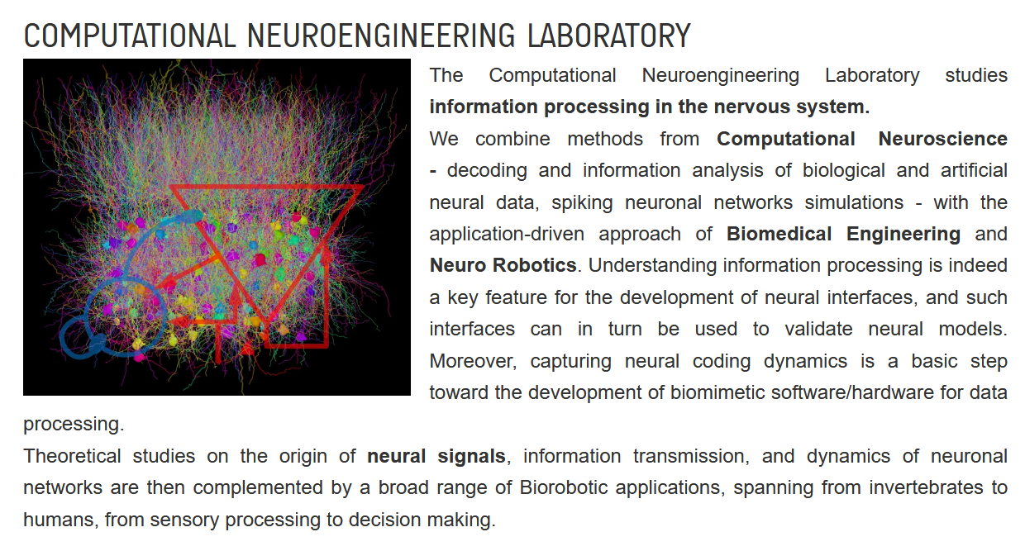



Slide 3
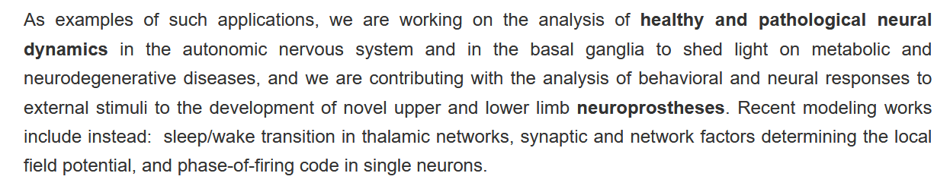
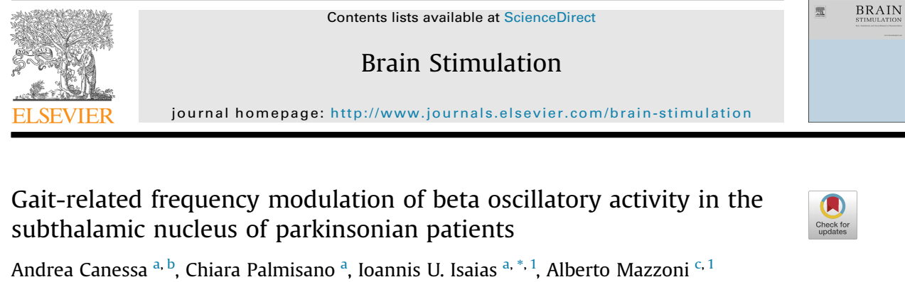
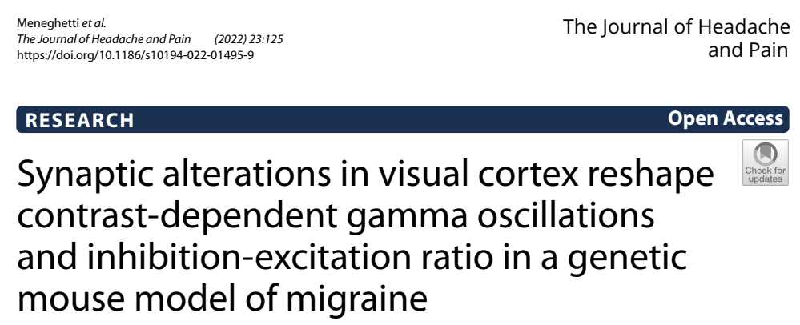

Slide 4


Slide 5

Neural Coding

Slide 6
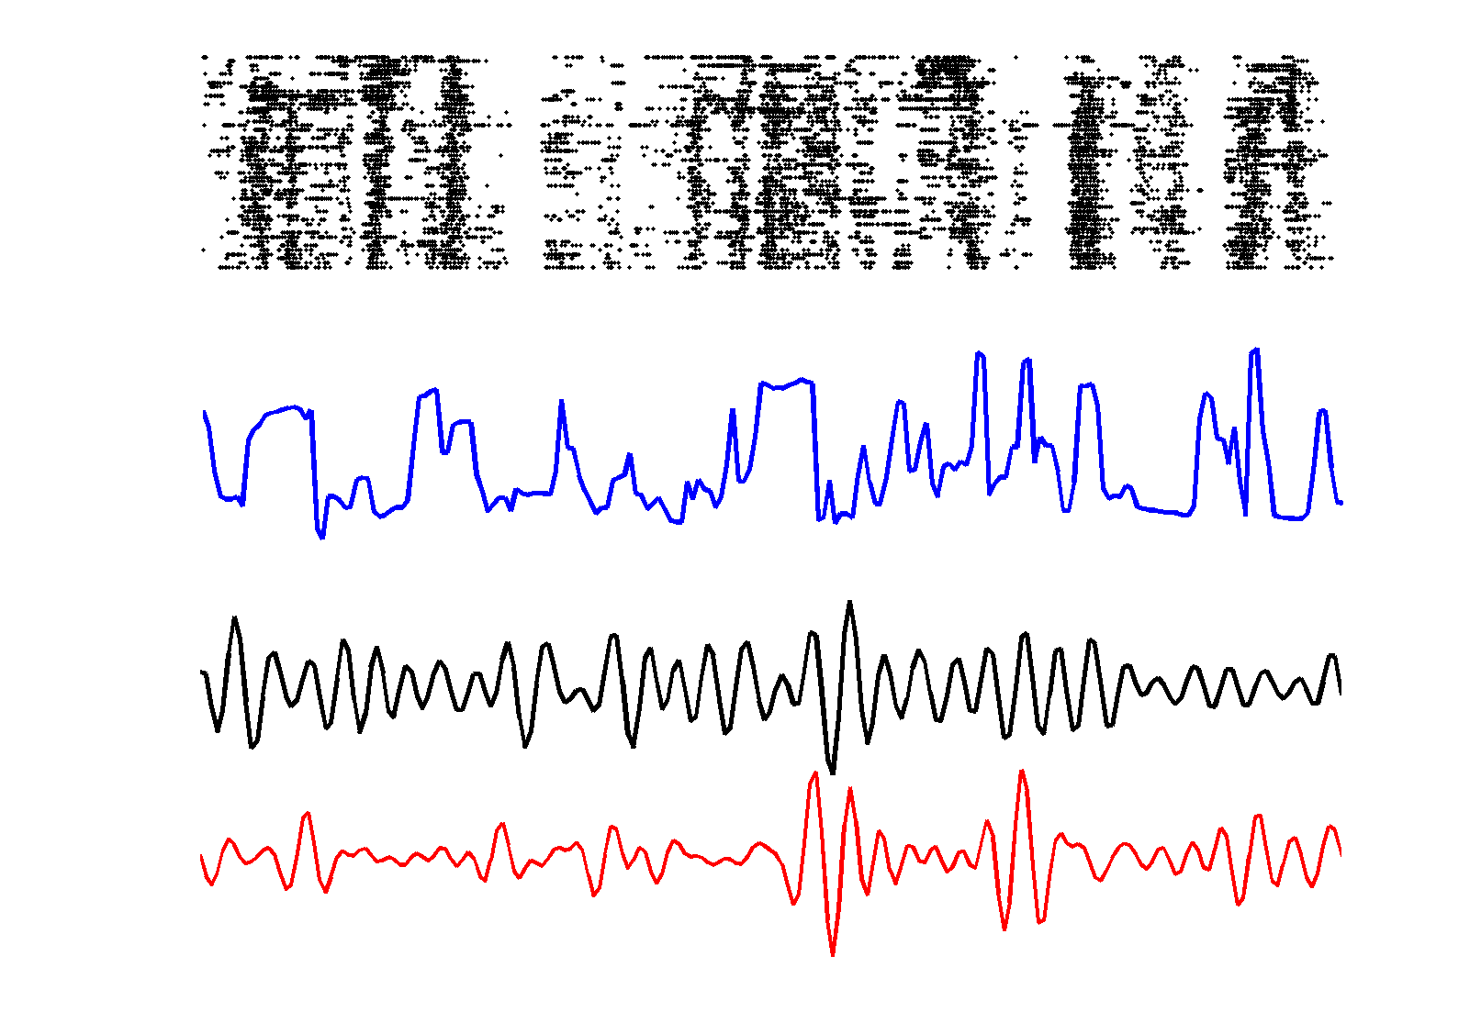
Neural Coding

Slide 7
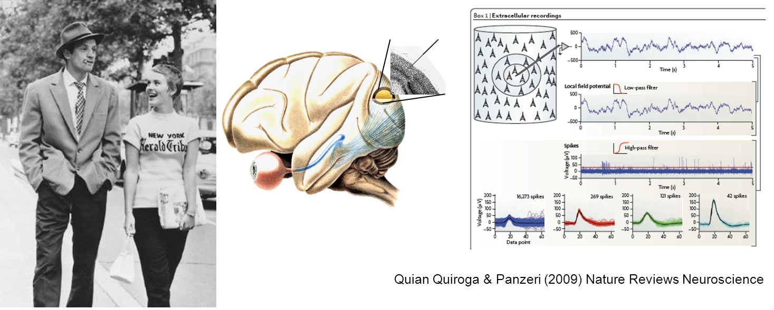
Neuronal Coding
How do neurons encode and transmit sensory and motor information?
What is the language (“code”) used by the neurons to transmit information to one another?

Slide 8
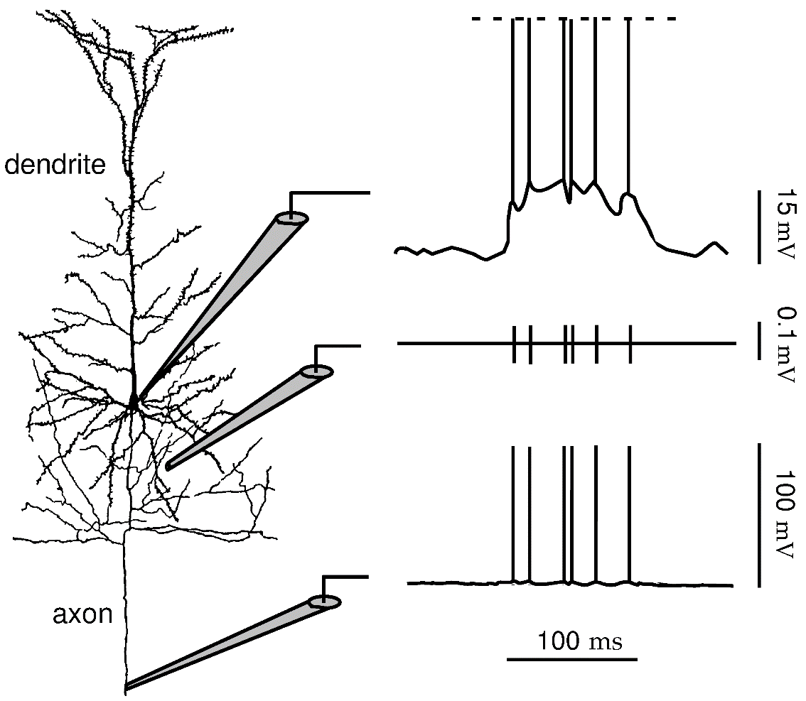
The neuronal code is a sequence of spikes
Somatic electrode – subthreshold membrane potential plus Action Potentials (spikes)
Extracellular electrode
Axonal electrode– subthreshold membrane potential are attenuated and only spikes propagate long distance

Slide 9
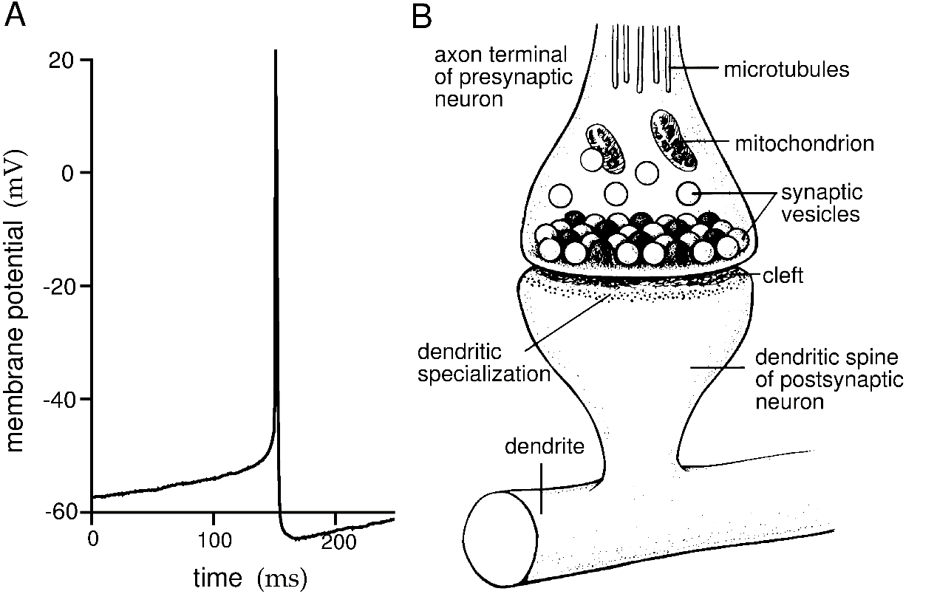
The synaptic vesicles in the axon terminal release neurotransmitters only when an action potential arrives from the presynaptic neuron
Thus, neurons communicate information only through action potentials, not through subthreshold membrane fluctuations.
Thus, the neuronal code consists of a time series of stereotyped action potentials
The neuronal code is a sequence of spikes

Slide 10

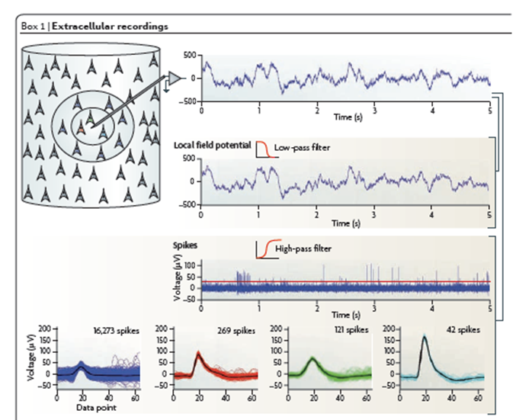
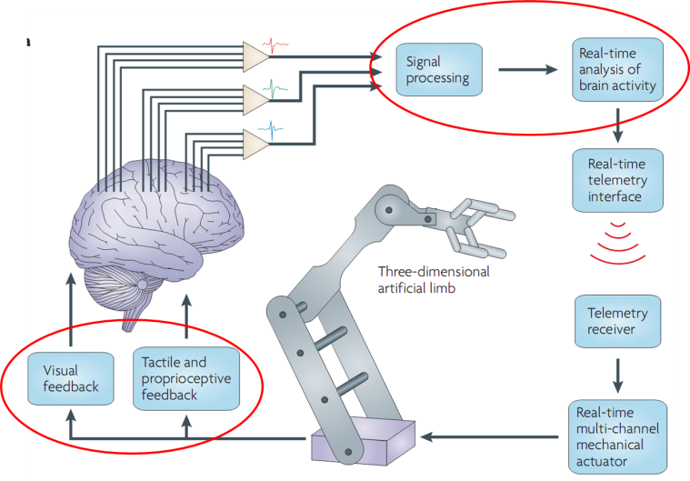
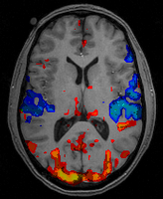
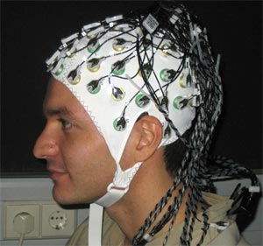
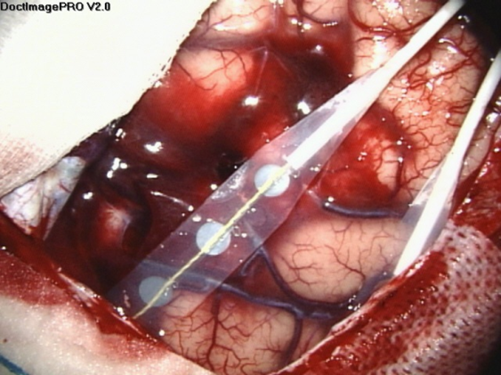
… but on our perspective, the code is
LFP
spikes
fMRI
ECoG
EEG

Slide 11
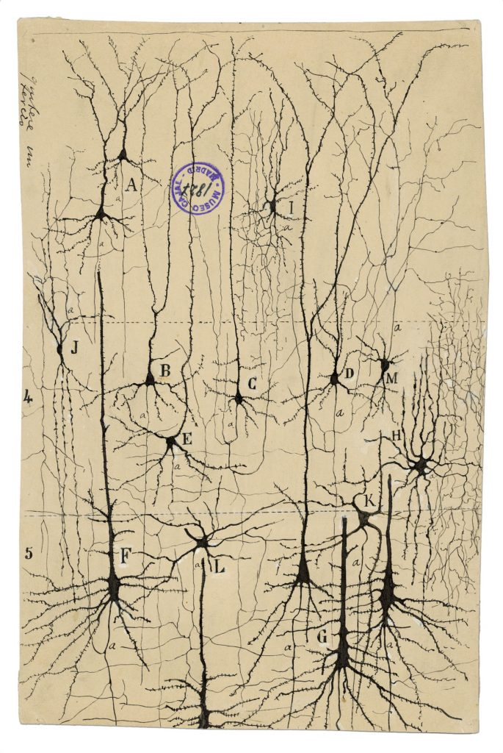
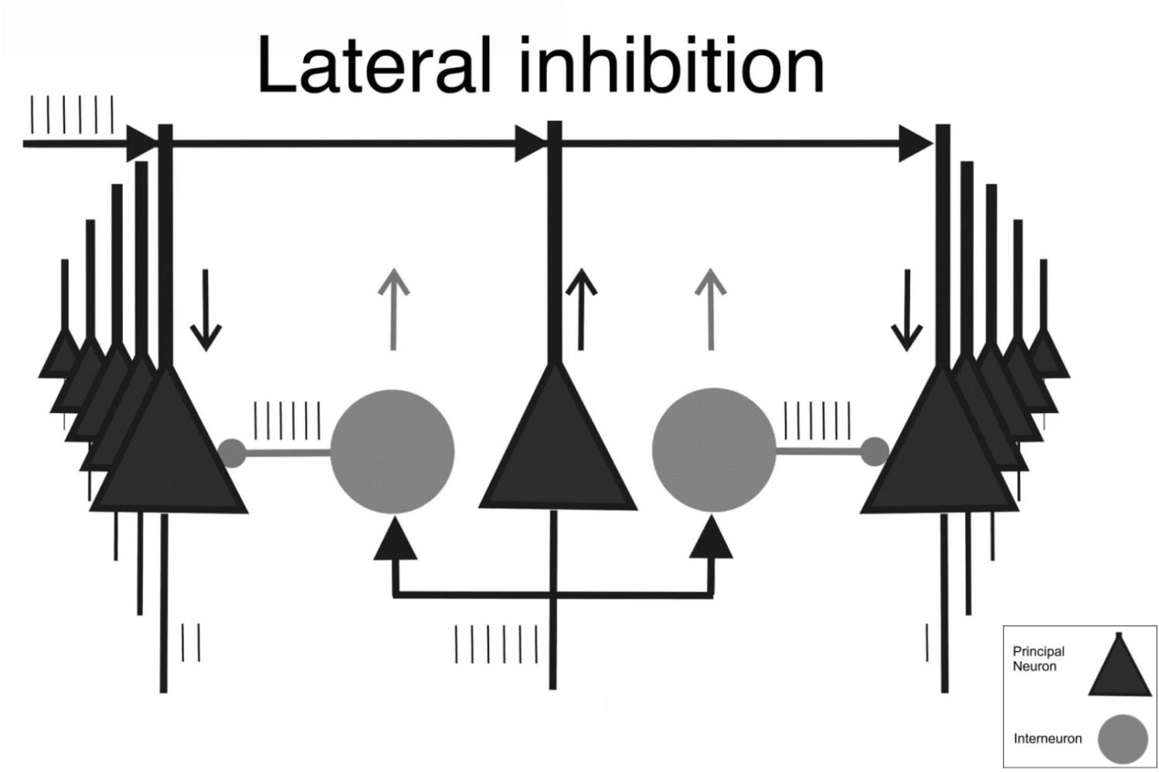
Neurons act in networks

Slide 12
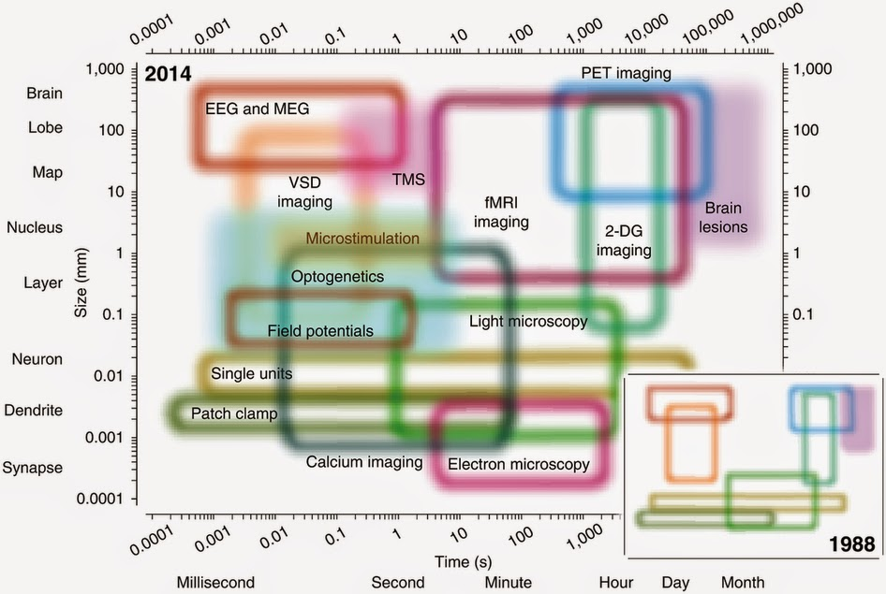

Slide 13
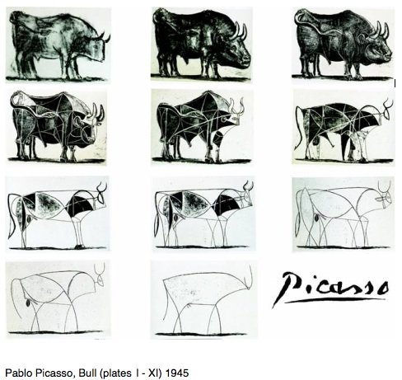
How do we know what we know

Slide 14

Neuronal Models

Slide 15

Why should I model neurons?
1) To get
ONE BILLION EUROS
From the European Community
https://www.humanbrainproject.eu

Slide 16
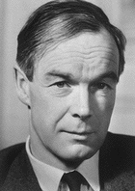
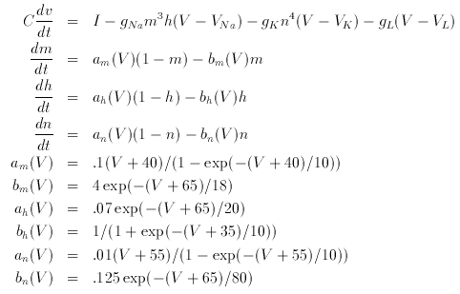

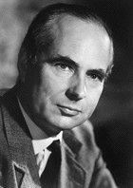
Why should I model neurons?
2) To win the Nobel prize
Hodgkin
Hodgkin and Huxley equations describing single neuron dynamics
Tested on giant squid axon
Huxley

Slide 17
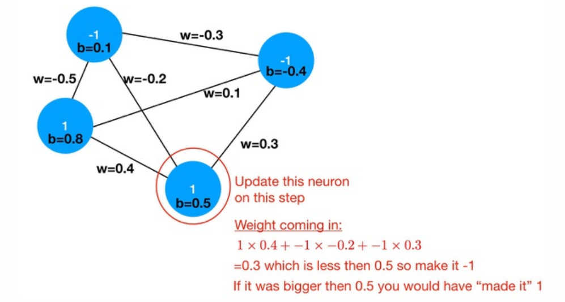

Why should I model neurons?
2) To win the Nobel prize IN PHYSICS

Slide 18

Why should I model neurons?
2) To win the Nobel prize IN PHYSICS

Slide 19

Why should I model neurons?
3) To become the best neuroengineer in the room

Slide 20

William of Ockham (c. 1287–1347)
entia non sunt multiplicanda praeter necessitatem
among all the models explaining the phenomenon under investigation, always choose the simplest

Slide 21
The simplest model
Observation: neurons communicate throug discrete events.
Each cell is a neuron: black active, white inactive.
Whenever a cell turns black (from inactive to active), triggers on average N neighbors

Slide 22
Simple model, complex consequences
Condition 1: N<1 – Inhibition dominating
Finite size, finite duration events
No communication is possible between different areas.
Band-limited power spectrum

Slide 23
Simple model, complex consequences
Condition 2: N>1 – Excitation dominating
Any stimulation ends with the whole network active (epilepsy)
Again no communication is possible
Bimodal power spectrum (no events AUT strong events)

Slide 24
Simple model, complex consequences
Condition 3: N=1 – Excitation-Inhibition balance
Virtually endless possible patterns
Optimal communication
Power law power spectrum (no characteristic timescale/size)

Slide 25
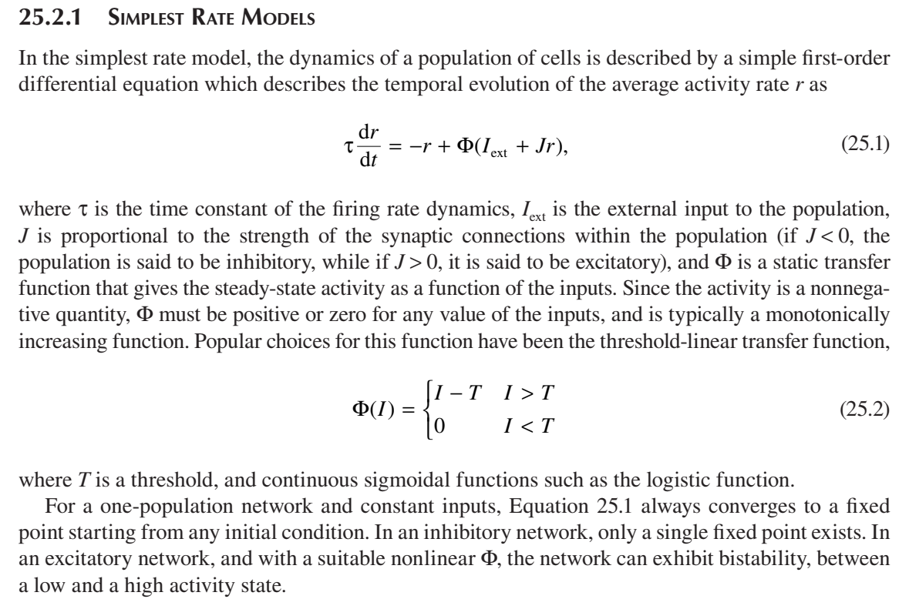
Introducing time: rate models

Slide 26
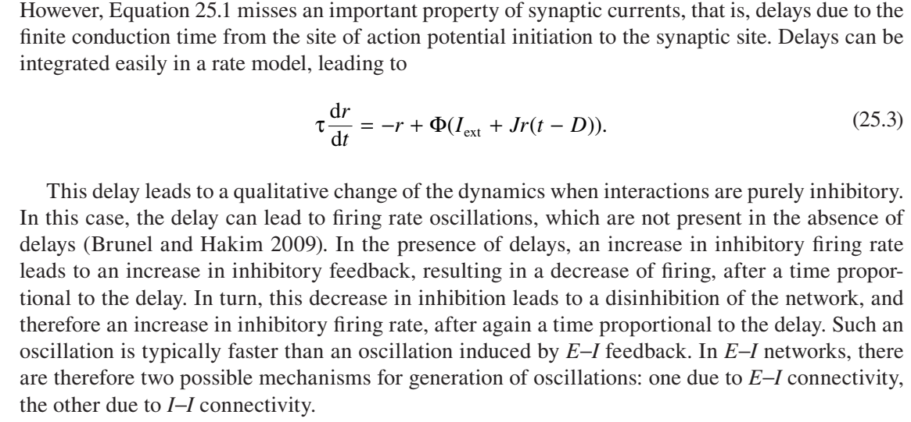
Introducing time: rate models

Slide 27
Introducing potential: the integrate and fire neuron
Spike
Threshold potential
Excitatory input
Reset
Excitatory input
Excitatory input
Membrane
potential
Time

Slide 28
Introducing potential: the integrate and fire neuron
Spike
Threshold potential
Excitatory input
This model is much simpler than HH since it does NOT simulate active sodium and potassium channels originating the action potential.
Reset
Excitatory input
Excitatory input
Membrane
potential
Time

Slide 29
Introducing inhibitory inputs the integrate and fire neuron
Spike
Threshold potential
Excitatory input
Reset
Inhibitory input
Inhibitory input
Excitatory input
Membrane
potential
Time

Slide 30
Introducing resting potential: the LEAKY integrate and fire neuron
Spike
Threshold potential
Excitatory input
Reset
Excitatory input
Comes back to resting
Excitatory input
Inhibitory input
Comes back to resting
Membrane
potential
Time

Slide 31
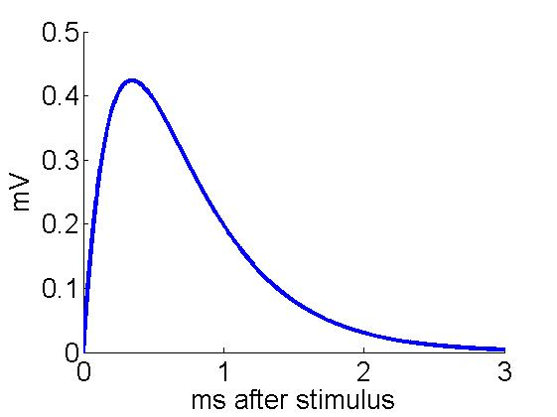
Leaky integrate-and-fire neuron
Only Excitatory and Inhibitory
synapses
Subthreshold:
Synaptic dynamics:
J
τr
τd
If
a spike is emitted
Vk drops to Vres
the neuron can not fire for a time τref
S
Other possibilities: NMDA synapses

Slide 32

Leaky integrate-and-fire neuron
Only Excitatory and Inhibitory
synapses
Subthreshold:
Synaptic dynamics:
$τ_{m}$= relaxation time of membrane potential (usually 20 ms or so, depends on the size of the soma)
Reset potential is set at 0 mV
$V_{A}$ indicates AMPA (excitatory) post-synaptic potentials (PSP)
$V_{G}$ indicates GABA (inhibitory) post-synaptic potentials (PSP)
J
τr
τd
If
a spike is emitted
Vk drops to Vres
the neuron can not fire for a time τref
S
Other possibilities: NMDA synapses

Slide 33

Leaky integrate-and-fire neuron
$τ_{r}$ indicates rise time of the PSP (1-5 ms usually) due to channel opening
$τ_{d}$indicates decay time of the PSP (3-10 ms usually) due to channel closing
$S_{k}^{stim}$ is 0 except when the neuron is receiving an input
$J_{k}^{stim}$ is the strength of the input
Only Excitatory and Inhibitory
synapses
Subthreshold:
Synaptic dynamics:
J
τr
τd
If
a spike is emitted
Vk drops to Vres
the neuron can not fire for a time τref
S
Other possibilities: NMDA synapses

Slide 34
Leaky integrate-and-fire neuron
Only Excitatory and Inhibitory
synapses
Subthreshold:
The solution of the coupled differential equation is a difference of exponential following the onset of each stimulus, with amplitude J.
Synaptic dynamics:
J
τr
τd
If
a spike is emitted
Vk drops to Vres
the neuron can not fire for a time τref
S
Other possibilities: NMDA synapses

Slide 35
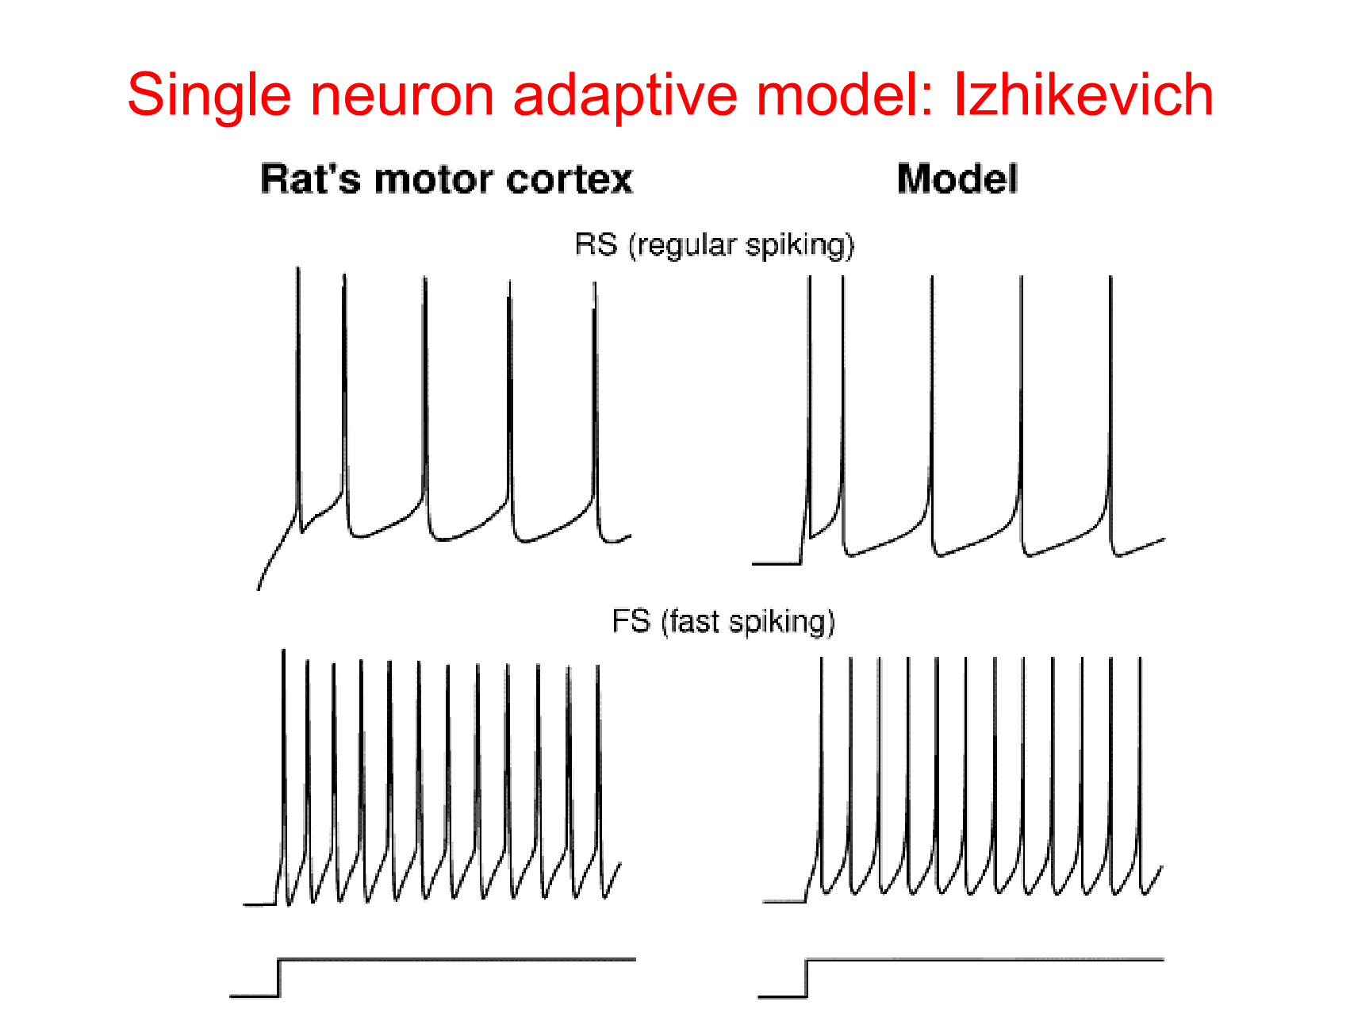

Slide 36
Adaptation: the input is constant but the inter-spike interval increases

Slide 37
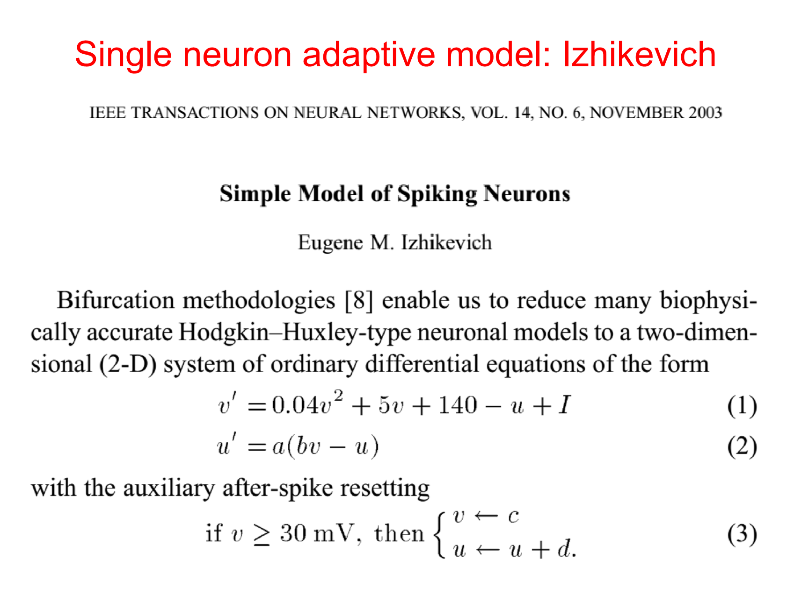

Slide 38
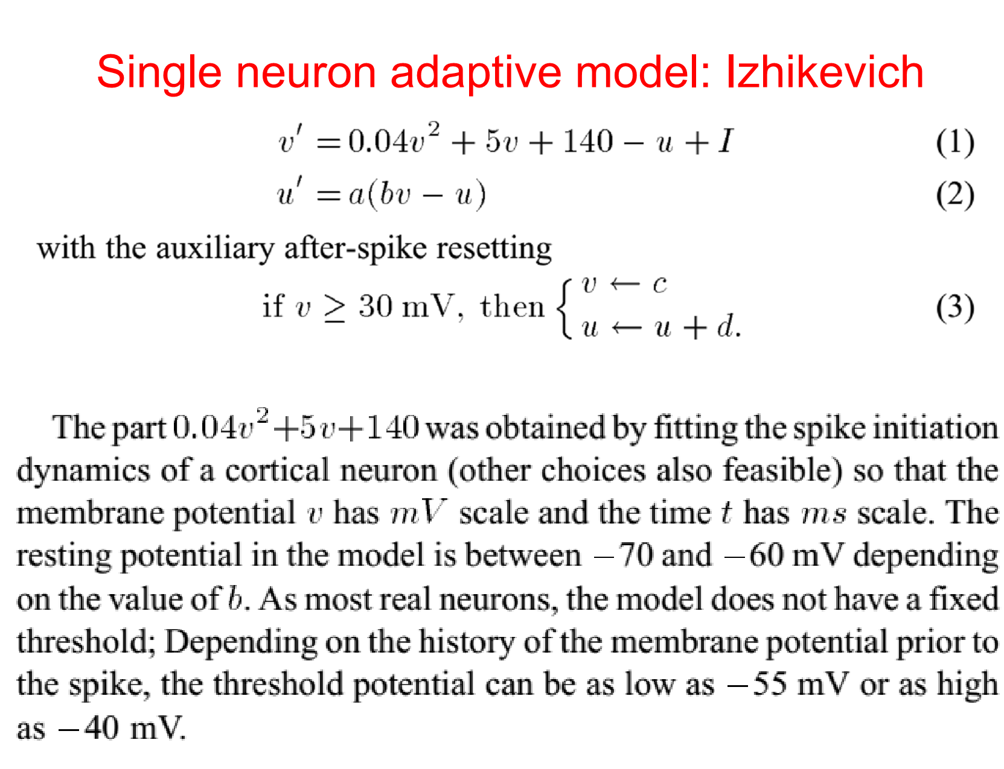

Slide 39
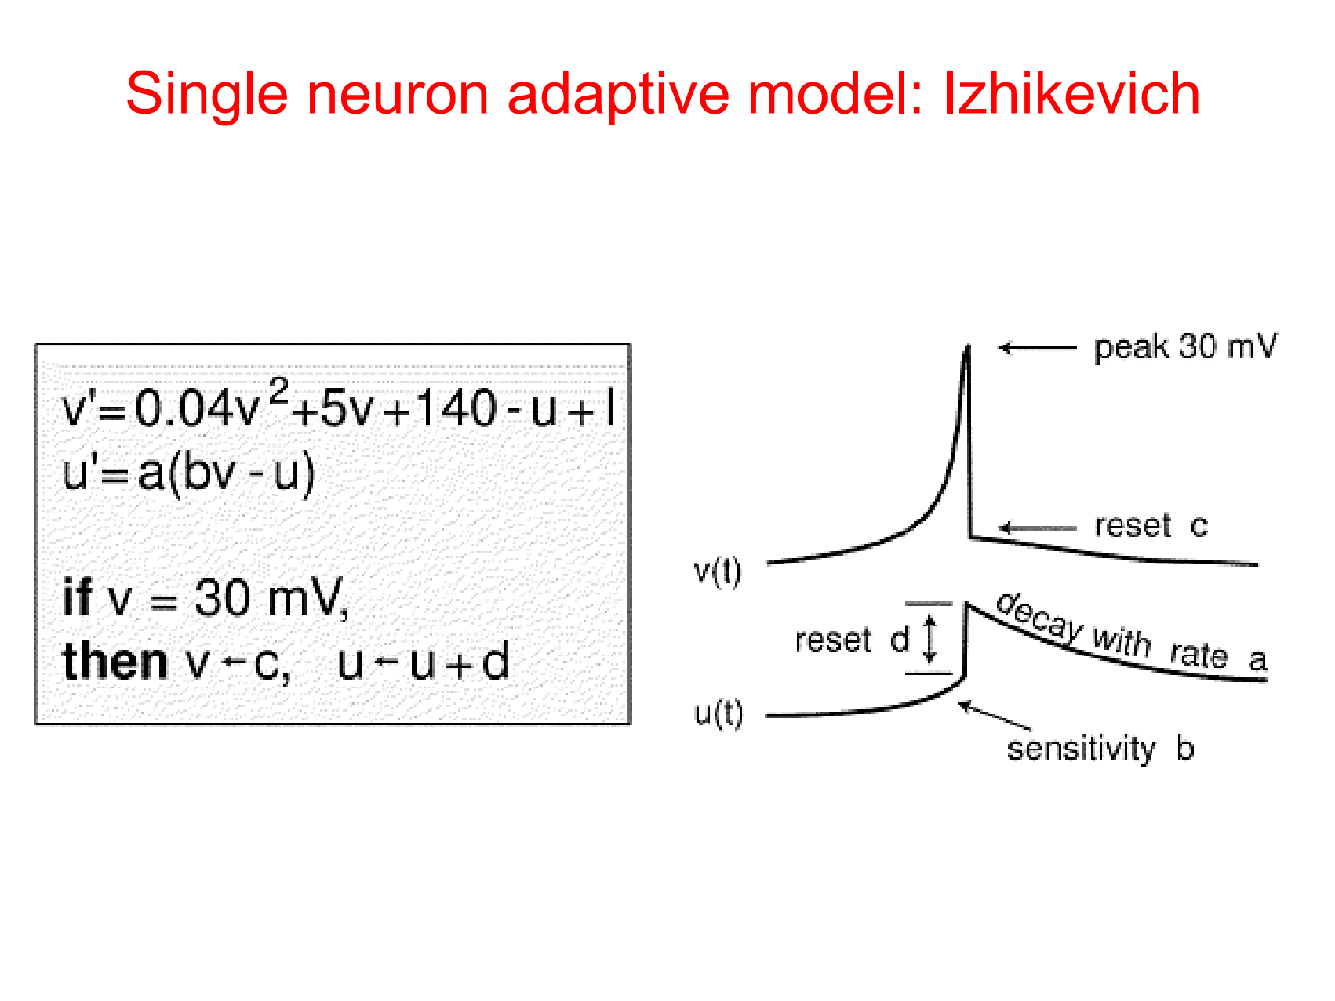

Slide 40
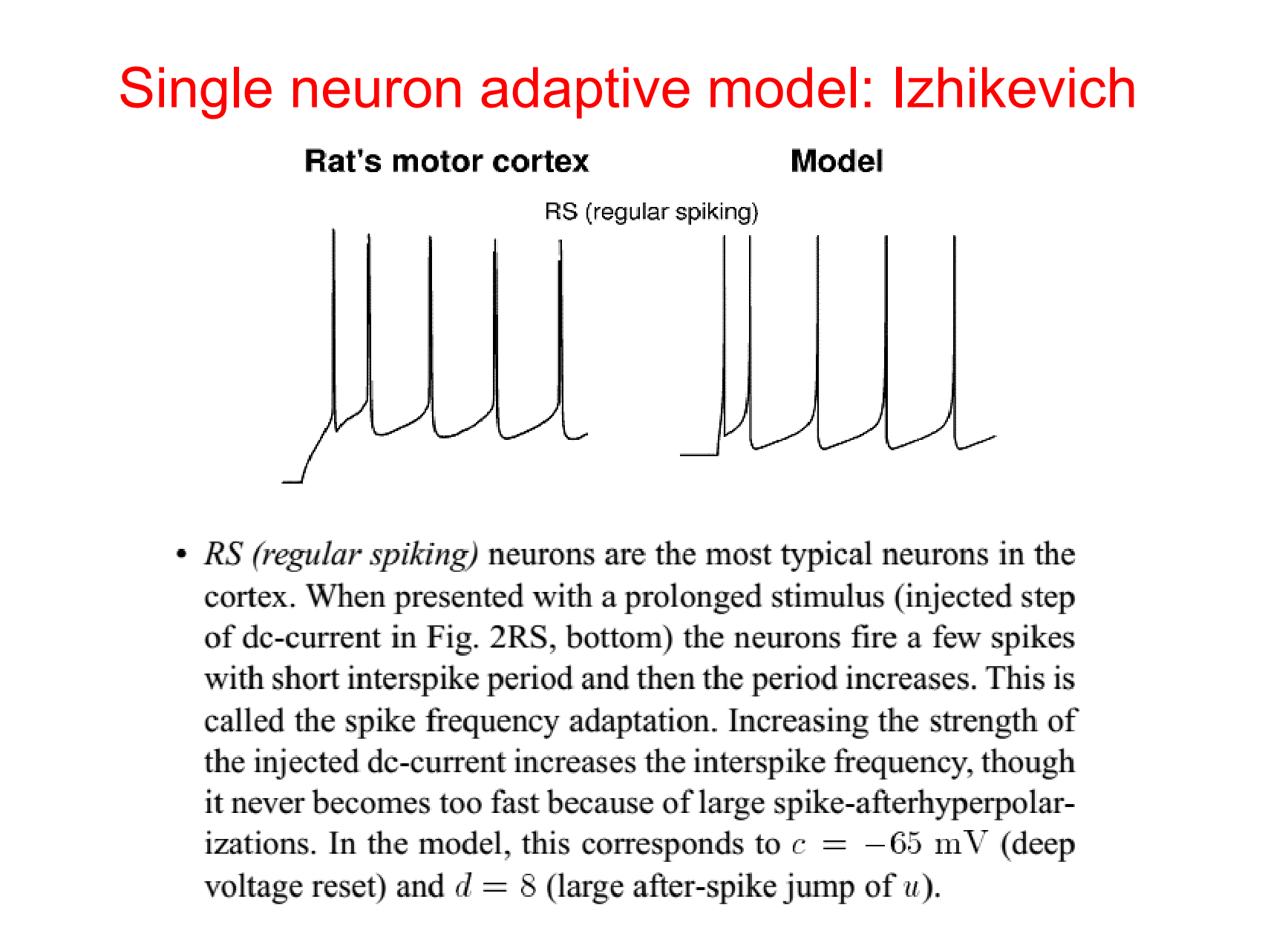

Slide 41
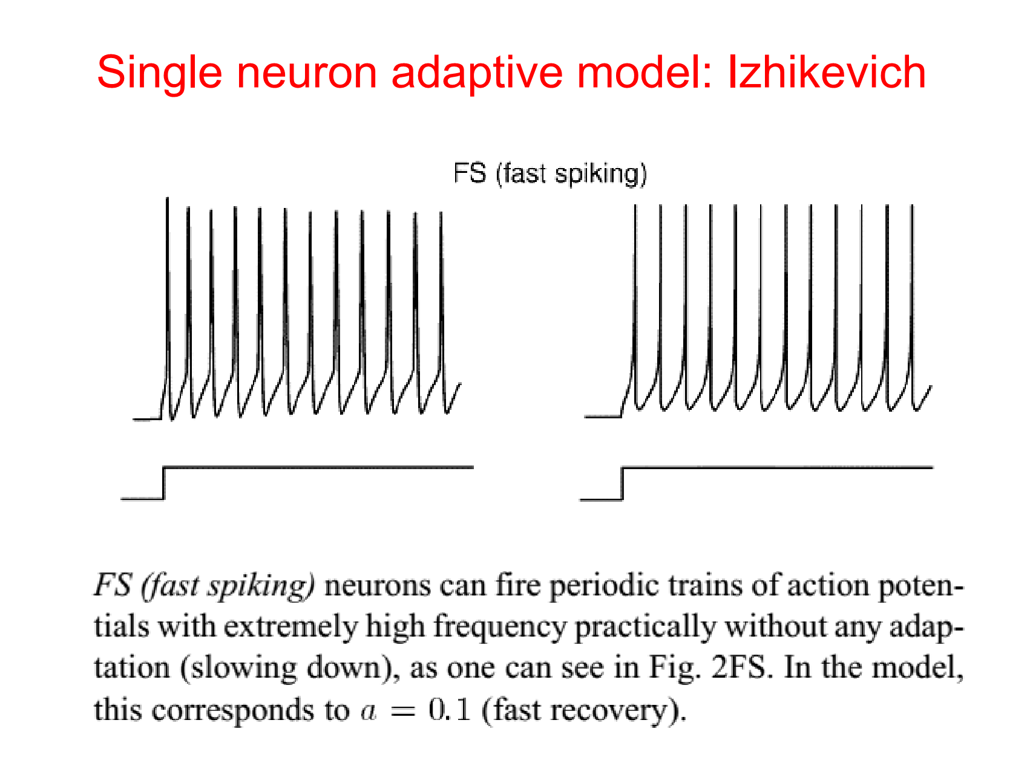

Slide 42
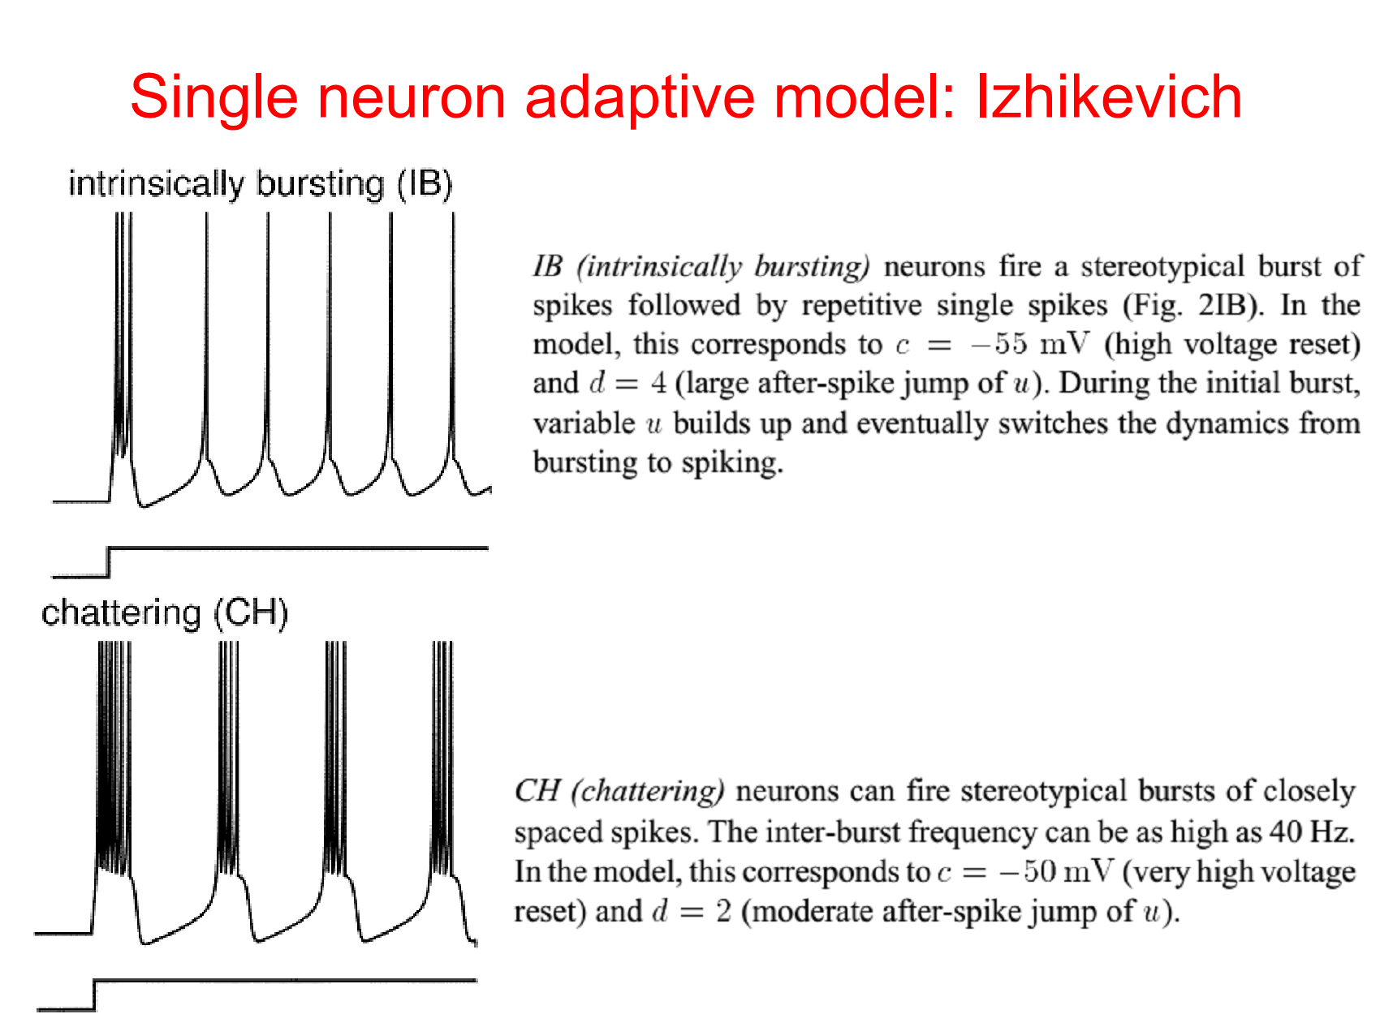

Slide 43
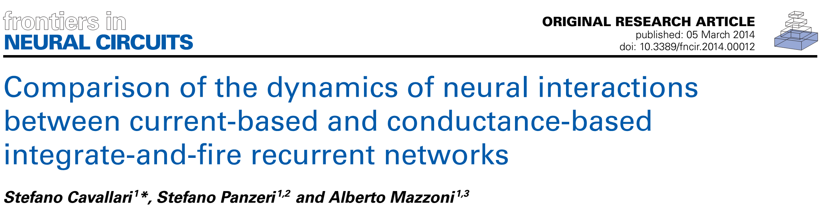
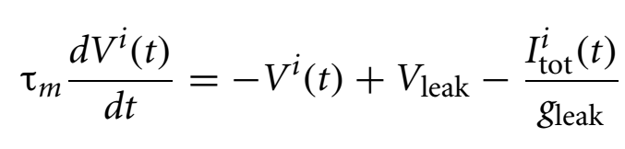
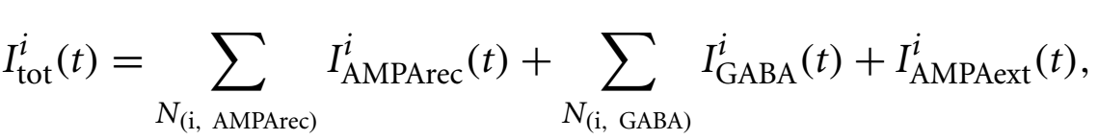

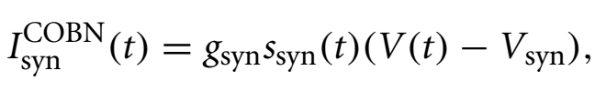
Conductance based

Slide 44
REVERSAL POTENTIAL (from Wikipedia) In a biological membrane, the reversal potential (also known as the Nernst potential) of an ion is the membrane potential at which there is no net (overall) flow of that particular ion from one side of the membrane to the other. In the case of post-synaptic neurons, the reversal potential is the membrane potential at which a given neurotransmitter causes no net current flow of ions through that neurotransmitter receptor's ion channel
Conductance based

Slide 45
Key Idea:
in CURRENT_BASED models the PSP does NOT depend on V(t)
in CONDUCTANCE_BASED models the PSP DOES depend on V(t)
Conductance based

Slide 46

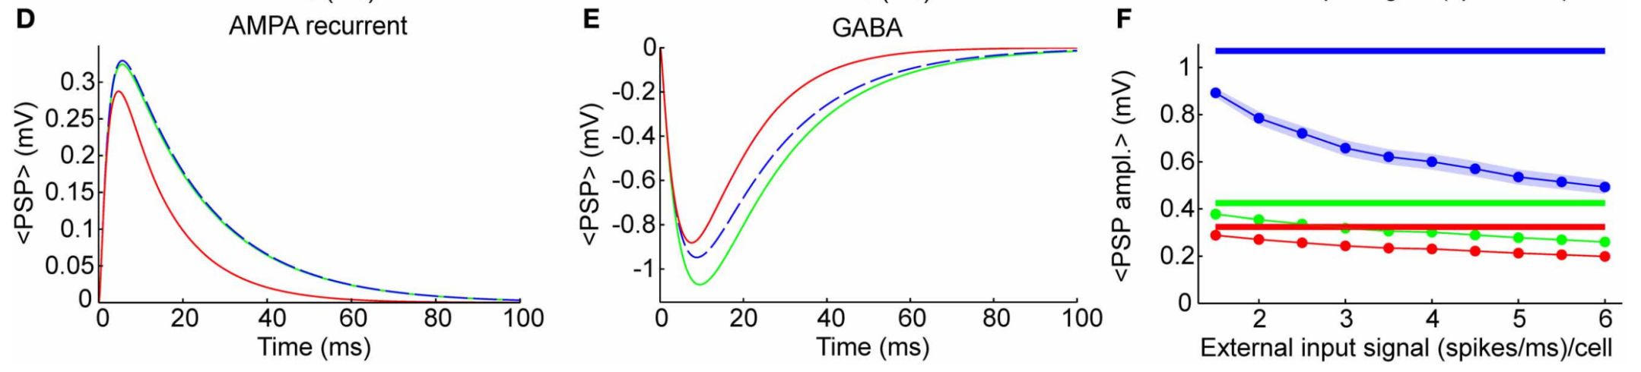
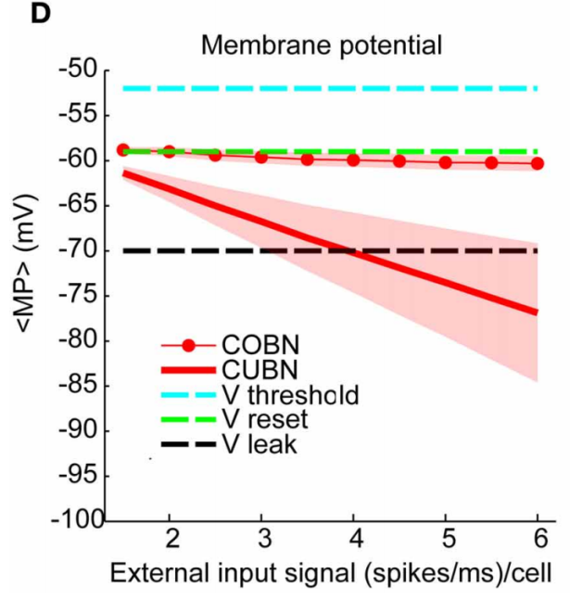
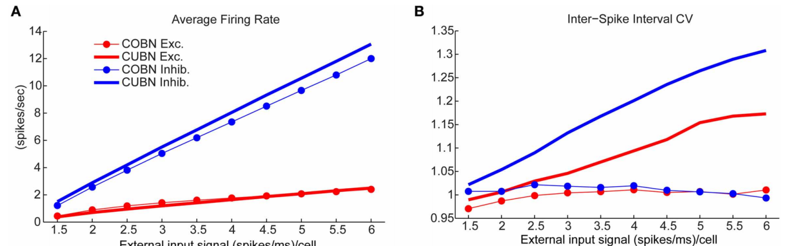

Slide 47
in CURRENT_BASED models V(t) can co arbitrarily low if inhibition is dominant (like here)
This does not happen in CONDUCTANCE BASED models, as inhibitory PSP’s amplitude decreases for low V(t)

Slide 48
Firing rate is similar in the two models
but
The coefficient of variation (CV) is much larger in CURRENT_BASED models – while for CONDUCTANCE_BASED is always 1 (as observed experimentally).

Slide 49
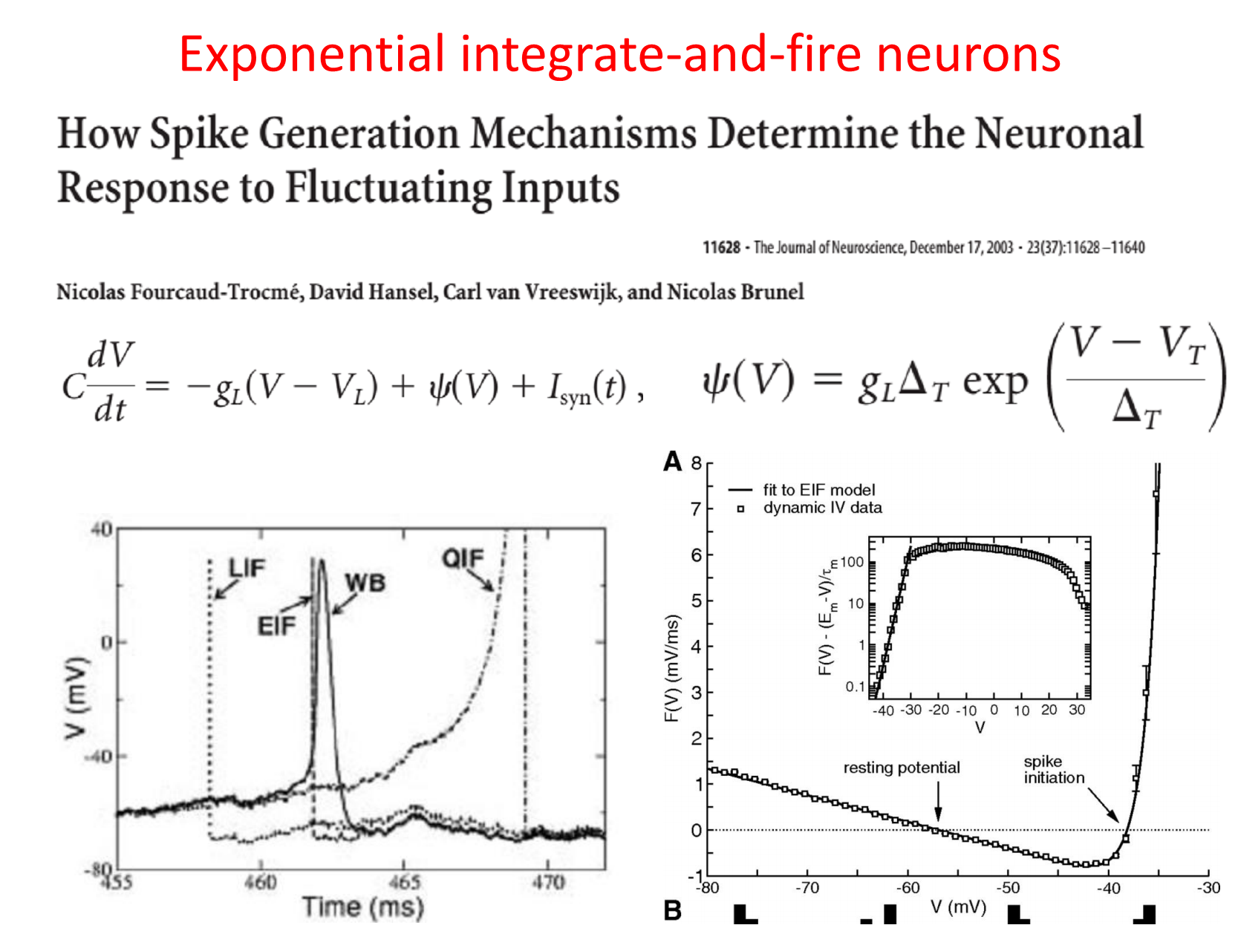

Slide 50
Note that now we have two thresholds: one for triggering the exponential rise (V_t in the equation in the left) and a second one (not explicited here) to cut the acton potential at 30 mV.

Slide 51
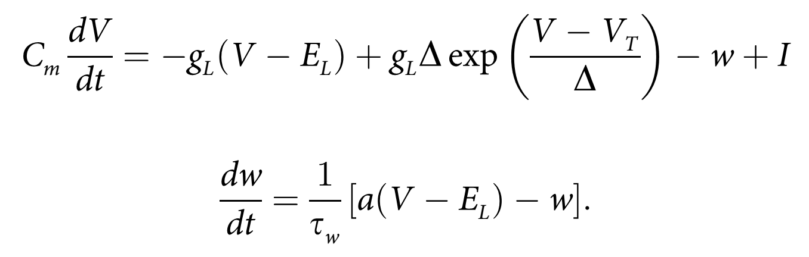
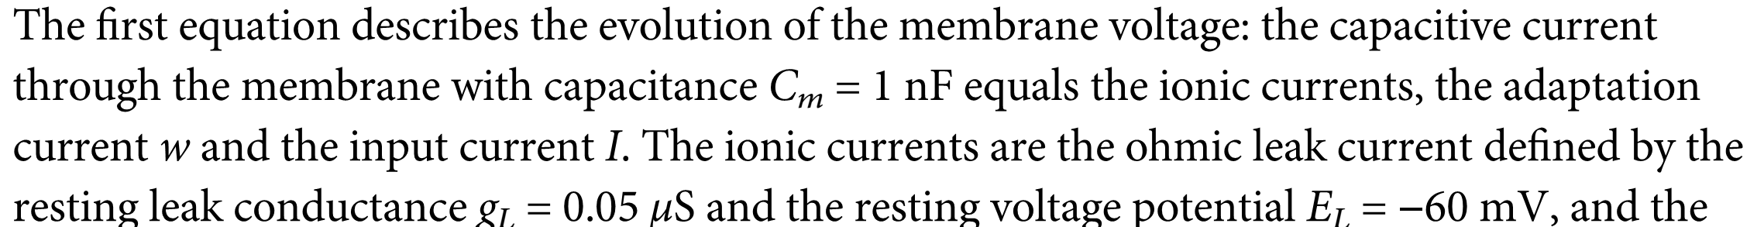
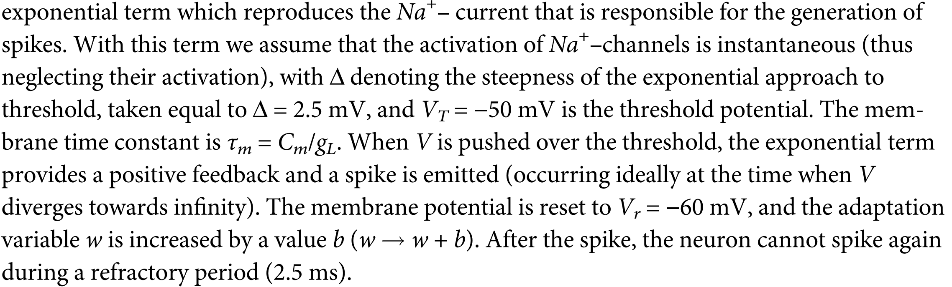
Adaptive exponential integrate-and-fire neuron

Slide 52
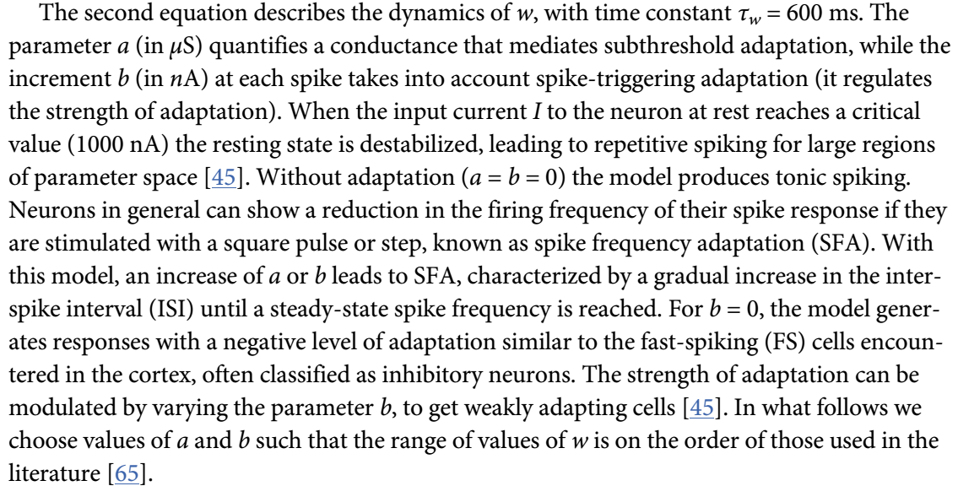
Adaptive exponential integrate-and-fire neuron

Slide 53
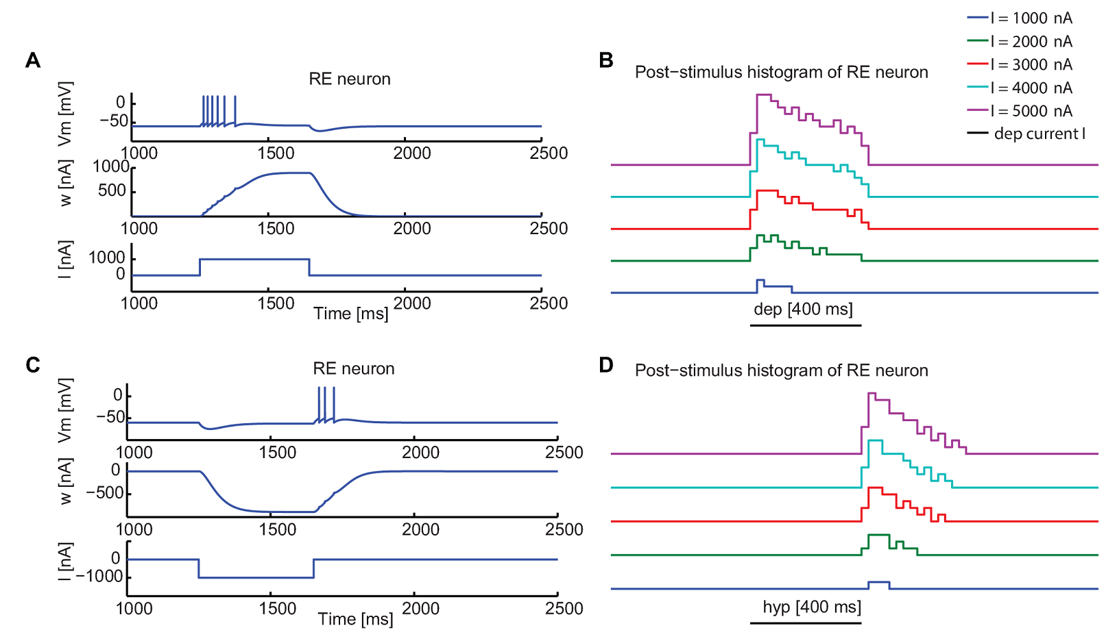
Adaptive exponential integrate-and-fire neuron

Slide 54
Adaptive exponential integrate-and-fire neuron
Firing for rebound from inhibition: if there’s a sustained inhibitory input the adaptation current becomes negative hence excitatory. When inhibition is released, the neuron emits a burst.

Slide 55
Increasing level of realism starting from LIF
Introducing ADAPTATION:
Izhikevich models (integrated)
Adaptive Exponential Integrate and Fire (plug-in)
Introducing ACTIVE CURRENTS:
HH models (the Nobel-prize squid)
EXC.
INH.
Introducing morphology:
NEURON
(and me)

Slide 56
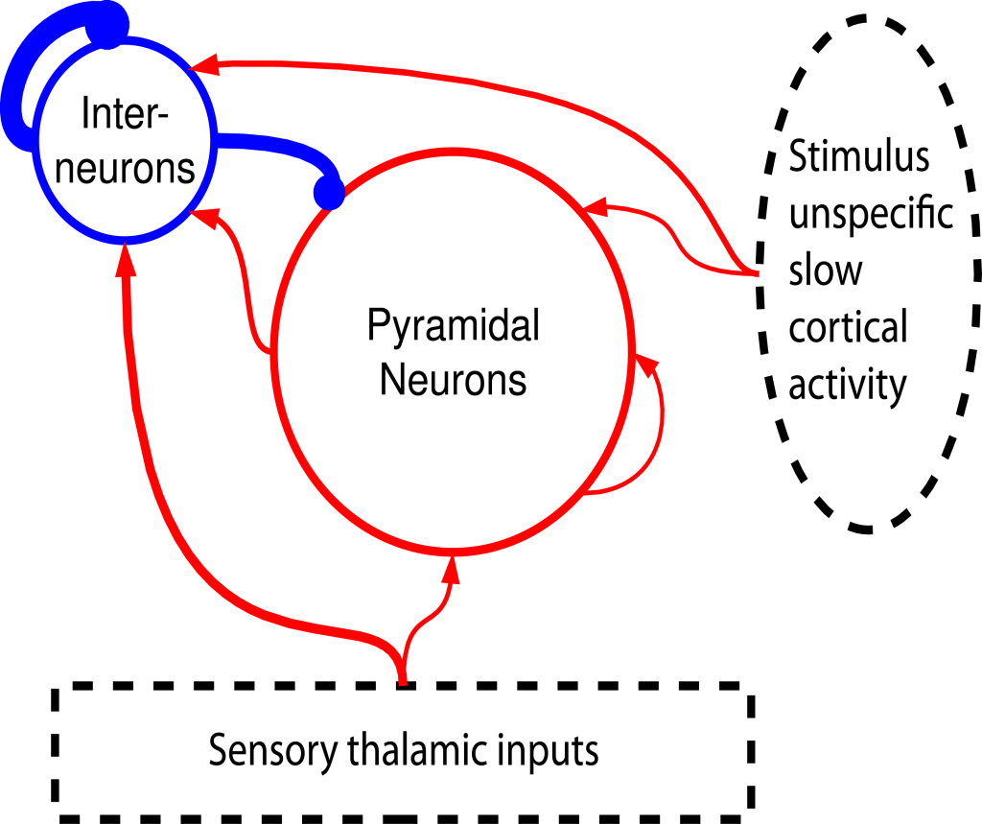
Introducing interaction:
Cortical recurring networks
4000 Excitatory neurons
1000 Inhibitory neurons
Sparse random connection (p=0.2)
Strong inhibition
.
Inhib.
Excitatory.

Slide 57
Introducing interaction:
Cortical recurring networks
4:1 excitatory/inhibitory ratio and strong inhibition combine to achieve excitatory/inhibitory
4000 Excitatory neurons
1000 Inhibitory neurons
Sparse random connection (p=0.2)
Strong inhibition
.
Inhib.
Excitatory.

Slide 58
Introducing external stimuli
4000 Excitatory neurons
1000 Inhibitory neurons
Sparse random connection (p=0.2)
Strong inhibition
Sensory thalamic inputs
(stronger on Inhibitory neurons)
Stimulus unspecific slowly varying inputs modeling ongoing cortical fluctuations.
Inhib.
Excitatory
Each thalamic input is injected many times - each time with a different ongoing activity.

Slide 59
Introducing external stimuli
Inhib.
Excitatory
“Ongoing activity” cortical inputs
Ornstein Uhlenbeck process
“Sensory” thalamic inputs
Mazzoni et al. PLoS Comp Biol 2008
Mazzoni et al. Neuroimage 2010
Mazzoni et al J Physiol 2012

Slide 60

Interlude: noise

Slide 61
Interlude: noise
It’s not possible to estimate the temporal structure of spontaneous cortical activity by measuring the firing of large (>10^3) pools of neurons – extracellular signals show a 1/f^2 spectrum (due to different size of neurons activated in phase)

Slide 62
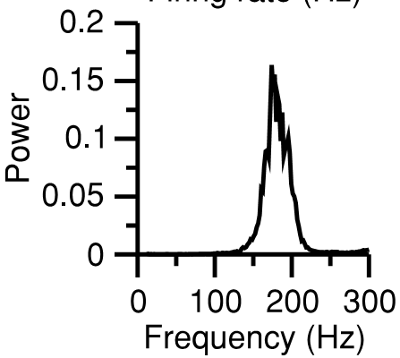
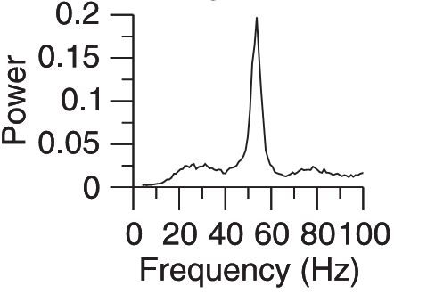
Consequences of interactions
I
I
P
E
Input
Input
I
P
E
Oscillations in the 30-150 Hz range – depending on the inhibition/excitation balance
Brunel-Wang 2003
Input

Slide 63
Consequences of interactions
Purely inhibitory network:
1- neurons are silent
2- external input activates neuron
3 – neurons self-inhibit
4- neurons are silent-> back to step 1
Oscillation is fast
I
I
P
E
Input
Input
I
P
E
Oscillations in the 30-150 Hz range – depending on the inhibition/excitation balance
Brunel-Wang 2003
Input

Slide 64
Consequences of interactions
Excitatory-inhibitory network:
1- E and I neurons
are silent
2- external input activates E neurons
3 – E neurons trigger I neurons activation: both sets are active
4- I neurons inhibit E neurons: only I neurons are active
5- I neurons do not receive excitatory inputs anymore.
6 - E and I neurons
are silent
-> back to step 1
Oscillations are slow
I
I
P
E
Input
Input
I
P
E
Oscillations in the 30-150 Hz range – depending on the inhibition/excitation balance
Brunel-Wang 2003
Input

Slide 65
Consequences of interactions
I
I
P
E
Complete network: both resonances are present. The input determines their interplay and hence the final frequency.
Input
Input
I
P
E
Oscillations in the 30-150 Hz range – depending on the inhibition/excitation balance
Brunel-Wang 2003
Input

Slide 66
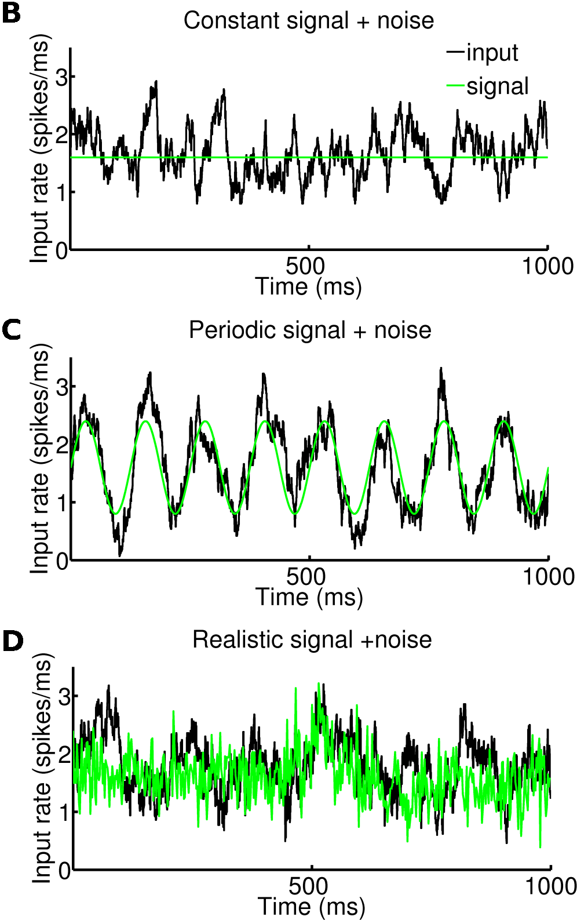

Integrate and fire models of local cortical excitatory-inhibitory networks
I
P
Unspecific
slow
cortical
activity
E
Thalamic input
Leaky integrate and fire neurons 4000 Excitatory Excitatory neurons 1000 Inhibitory Inhibitory neurons.
Sparse (p=0.2) random connections

Slide 67
Integrate and fire models of local cortical excitatory-inhibitory networks
Excitatory SINK
ELECTRODE
Excitatory neurons
Inhibitory SOURCE
Inhibitory neurons
LFP modeled as sum of absolute values of Excitatory and Inhibitory currents on Excitatory neurons

Slide 68
Integrate and fire models of local cortical excitatory-inhibitory networks
Excitatory SINK
Dipole effect: the distance between sink and source creates a dipole
ELECTRODE
Excitatory neurons
Inhibitory SOURCE
Inhibitory neurons
LFP modeled as sum of absolute values of Excitatory and Inhibitory currents on Excitatory neurons

Slide 69
Integrate and fire models of local cortical excitatory-inhibitory networks
Dipoles sum:
Parallel dipoles formed by excitatory neurons sum up linearly
Isotropic dipoles formed by inhibitory neurons sum up to zero over a sufficiently large volume
Excitatory SINK
ELECTRODE
Excitatory neurons
Inhibitory SOURCE
Inhibitory neurons
LFP modeled as sum of absolute values of Excitatory and Inhibitory currents on Excitatory neurons

Slide 70
Integrate and fire models of local cortical excitatory-inhibitory networks
I
P
Unspecific
slow
cortical
activity
E
Thalamic input
Leaky integrate and fire neurons 4000 Excitatory Excitatory neurons 1000 Inhibitory Inhibitory neurons.
Sparse (p=0.2) random connections

Slide 71
Network response
to constant input
input:
costant signal + noise
Inhibitory neurons
spike rate
Excitatory neurons
spike rate
LFP=|I_{Excitatory}|+|I_{Inhibitory}|
on Excitatory neurons

Slide 72
Network response
to constant input
input:
costant signal + noise
Weak synchronization:
Oscillations are not visible in single neurons but only on local field potentials (or total firing rate, that is not accessible to experimenters)
Inhibitory neurons
spike rate
Excitatory neurons
spike rate
LFP=|I_{Excitatory}|+|I_{Inhibitory}|
on Excitatory neurons

Slide 73


Network response to constant input
Inhibitory neurons
spike rate
Excitatory neurons
spike rate
The network internally generates only gamma-range (40-100 Hz) oscillations
The gamma power encodes the strength of the input
LFP=|I_{Excitatory}|+|I_{Inhibitory}|
on Excitatory neurons
Mazzoni, et al – PLoS Comp Biol (2008)
Mazzoni et al (2010) Neuroimage

